Slide 1

Power Point Presentation
AirAware
air quality prediction system
By Varshini Reddy

Slide 2
What we’ll cover
Project Overview
Technologies Used
objectives
Key features implemented
Conclusion
System workflow

Slide 3
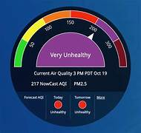

Project Overview — AirAware: Smart Air Quality Prediction System

Slide 4



The story behind AirAware
AirAware was inspired by the need to make invisible air pollution visible and easy to understand.
Most people check the weather daily, but rarely check the air quality that directly affects their health.
This motivated us to design a system that monitors, analyzes, and predicts air quality using machine learning.
We wanted a simple, interactive dashboard where users can select a city and instantly view AQI and pollutant levels.
By using gauges, color indicators, and trend charts, AirAware transforms complex data into clear insights.
Our goal is to create more awareness and provide early warnings about unhealthy air conditions.
In the end, AirAware stands as our effort to help communities stay informed, safe, and environmentally responsible.

Slide 5
Technologies Used
Front End
Backend
Dataset
  HTML5 – for structuring the user interface
  CSS3 – for styling
  JavaScript – for dynamic AQI
  Chart.js – for AQI trend graph visualization
  Google Fonts – for custom, cleatypography
  Python – main backend programming language
  Flask / FastAPI – to build APIs that send model predictions to the UI
  JSON API Responses – for sending AQI + pollutant values to frontend
Air Quality Prediction of Andhra Pradesh (Kaggle)
  The dataset contains real air quality measurements collected from different cities in Andhra Pradesh.
  It includes major pollutant features such as PM2.5, PM10, NO₂, SO₂, CO, and the overall AQI.

Slide 6

Build a simple and interactive dashboard to display AQI.
Predict air quality using machine learning techniques.
objectives
Provide pollutant-level insights (PM2.5, PM10, NO₂, SO₂, CO).
Enable users to select cities of AP.

Slide 7

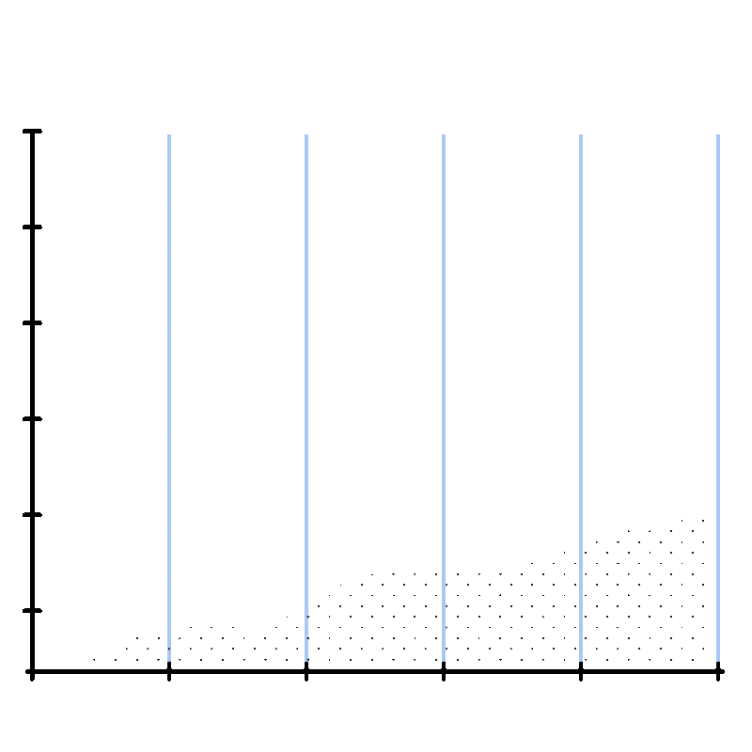
Key features
  Interactive Dashboard: A clean and user-friendly UI that displays AQI, pollutant levels, and trends in a visually appealing layout.
  Dynamic AQI Updates: The dashboard generates and displays updated AQI and pollutant values instantly for each selected city.
  Color-Based Alerts: The UI changes theme colors based on AQI category (Good, Moderate, Poor, Unhealthy) for instant visual understanding.
  Graphical Visualizations: Line charts and gauge views are used to show AQI trends and pollutant distribution in an intuitive way.
  Smooth Animations & Effects: Hover effects, scroll animations, and alert flashes enhance the user's interaction experience

Slide 8
System Workflow
1. User Interaction & City Selection
2. Frontend Processing & Visualization
4. Prediction & Trend Analysis (ML Model)
3.Backend Data Handling (Flask API)

Slide 9
Visual Output

Slide 10
Conclusion
AirAware simplifies air quality monitoring by converting complex pollution data into easy-to-read visual insights.
The project promotes awareness, supports healthier decision-making, and lays the foundation for future real-time air quality prediction systems.

